Slide 1
Models of the motor system
Fall 2021
Opher Donchin

Slide 2
Part 1
Error based and reward based learning

Slide 3
A model of error based learning
Plasticity
Purkinje
Cells
Error
Efferent
copy
Plasticity
Deep
Cerebellar
Nuclei
Inferior
Olive
Pontine
nuclei
Feedback
Context
Motor output

Slide 4
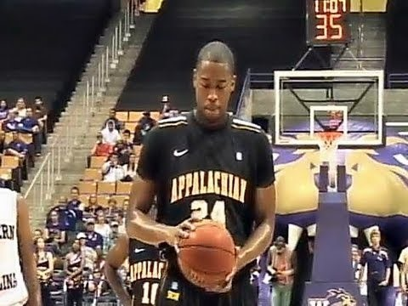
Obligatory sports video
https://www.youtube.com/embed/8dLx53NanQ0

Slide 5
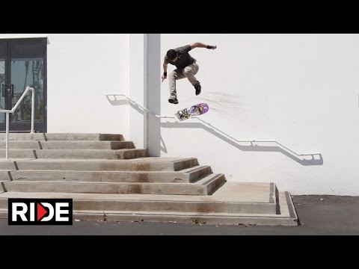
Error based learning may not work here
https://www.youtube.com/embed/S9KE2R92pSg

Slide 6
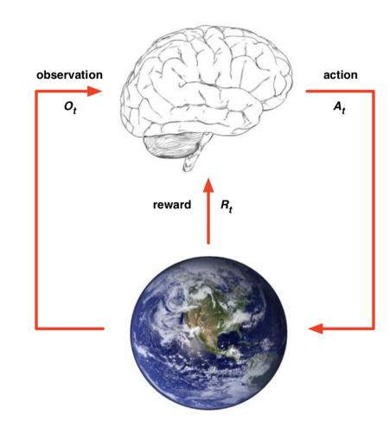
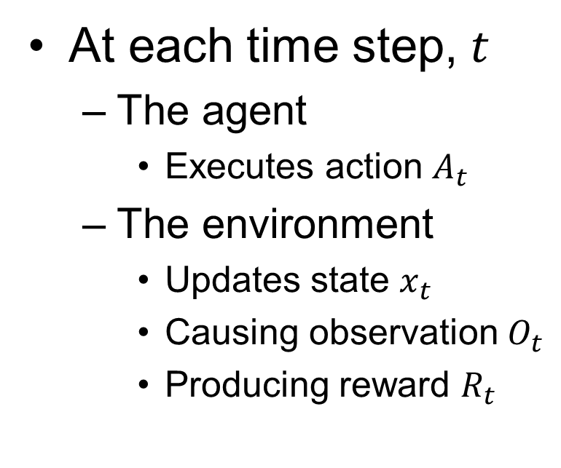
A model of reinforcement learning
At each time step, $t$
The agent
Executes action $A_{t}$
The environment
Updates state $x_{t}$
Causing observation $O_{t}$
Producing reward $R_{t}$

Slide 7
Part 2
What is reinforcement

Slide 8
Reward
Something an animal will seek out
Positively motivating to the animal

Slide 9
Reward examples
Food for an experimental animal
Points in a video game
Performing desired movement

Slide 10
Complex rewards
Food for an experimental animal
In minimum time
Points in a video game
But not dying
And collecting prizes
Performing desired movement
With minimal effort
Optimizing a functional
Under constraints
Minimizing task-relevant variability

Slide 11
Reinforcement
An environmental response
To a behavior
That increases the chance of that behavior

Slide 12
Reward and reinforcement
Reward
Something the animal seeks out
Reinforcement
Something that promotes a behavior
A reward, paired with a behavior
Becomes a reinforcement

Slide 13
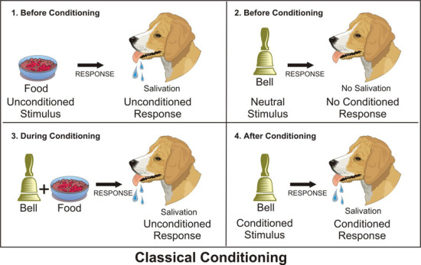
Classical conditioning
Pavlov’s dog
“Learns” that the bell means food
Bell becomes rewarding

Slide 14
Reinforcement and punishment
Reinforcement
Increase behavior
Positive
Candy for the winner of a quiz
Negative
Free time if we get through the material
Punishment
Decrease behavior
Positive
Do extra homework if late for class
Negative
Lose points for late submission

Slide 15
Part 3
What is reinforcement learning

Slide 16
Reward based learning
Error based learning
Response to behavior is signed or vectorial
Indicates direction for change
Possibility for optimum
Reward based learning
Response to behavior is positive scalar
Indicates relative success
No indication of direction for change
No indication of optimum

Slide 17
Reinforcement learning
Reward based
Attempts to maximize reward over time
Must predict rewards
Must learn actions that maximize rewards

Slide 18
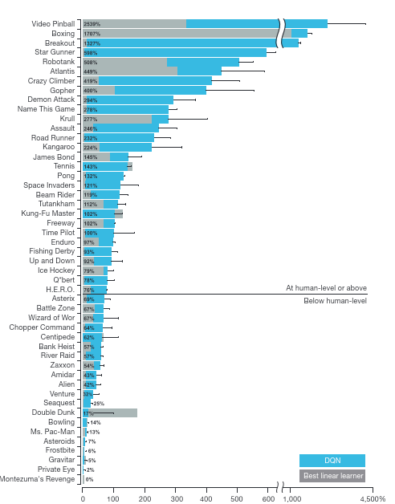
Heavily used in machine learning
Reinforcement learning beats human players in video games
Self-driving cars
Robotics
Medical diagnosis
Basic to deep learning

Slide 19
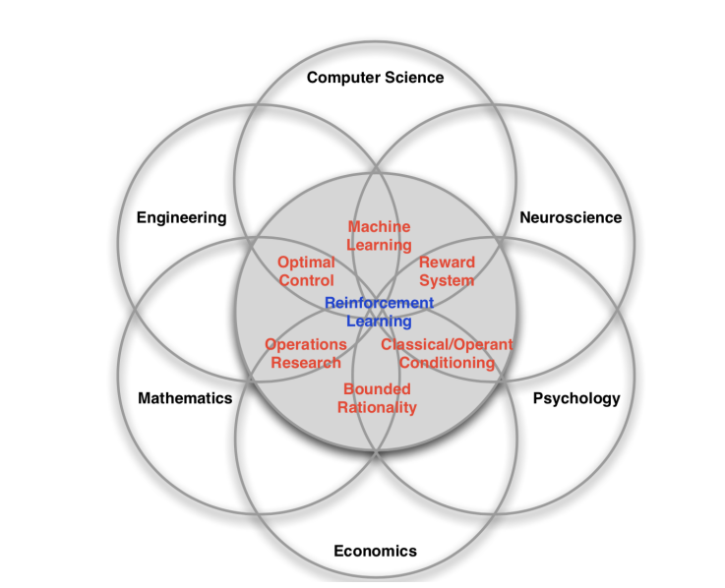
Enormously influential

Slide 20
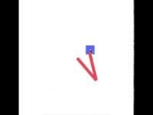
Learning to move robot arm
Demo for python-based reinforcement learning toolbox
https://www.youtube.com/watch?v=BZLX-Bilqzg

Slide 21
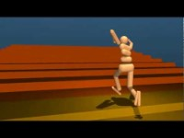
Learning locomotion
https://www.youtube.com/watch?v=BZLX-Bilqzg

Slide 22
Part 4
Algorithms of reinforcement learning

Slide 23
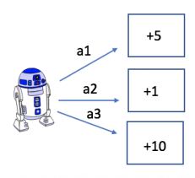
Maximize reward
Learn rewards
Choose action with best reward

Slide 24
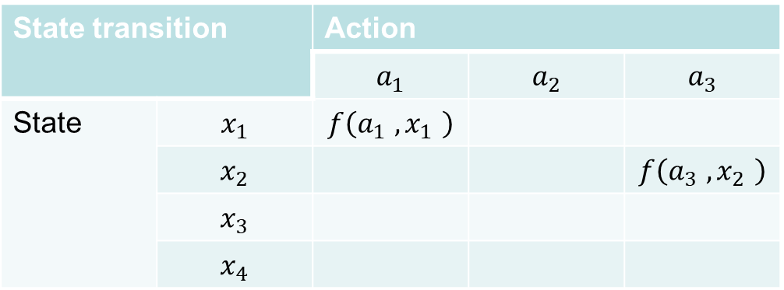
State transition function
This could be given or learned
It doesn’t have to be discrete
State transition |  | Action
 |  | $$a_{1}$$ | $$a_{2}$$ | $$a_{3}$$
State | $$x_{1}$$ | $$f\left(a_{1} ,x_{1} \right)$$
 | $$x_{2}$$ |  |  | $$f\left(a_{3} ,x_{2} \right)$$
 | $$x_{3}$$
 | $$x_{4}$$

Slide 25
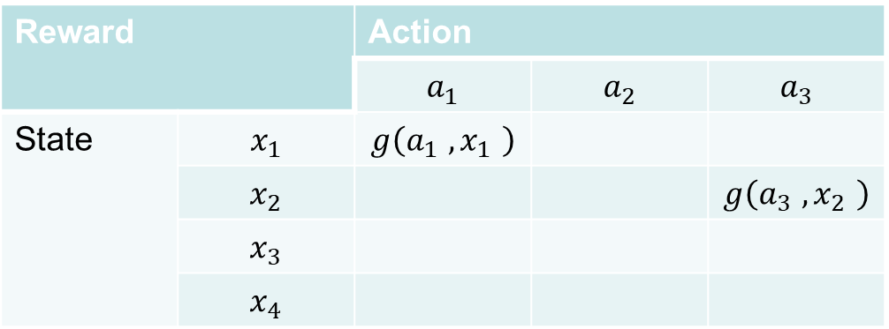
True reward function
This is unknown to the learner
Reward |  | Action
 |  | $$a_{1}$$ | $$a_{2}$$ | $$a_{3}$$
State | $$x_{1}$$ | $$g\left(a_{1} ,x_{1} \right)$$
 | $$x_{2}$$ |  |  | $$g\left(a_{3} ,x_{2} \right)$$
 | $$x_{3}$$
 | $$x_{4}$$

Slide 26

Estimated reward function
Guessed by the learner
So far
And updated
Reward |  | Action
 |  | $$a_{1}$$ | $$a_{2}$$ | $$a_{3}$$
State | $$x_{1}$$ | $${\hat{r}}_{t}\left(a_{1} ,x_{1} \right)$$
 | $$x_{2}$$ |  |  | $${\hat{r}}_{t}\left(a_{3} ,x_{2} \right)$$
 | $$x_{3}$$
 | $$x_{4}$$

Slide 27
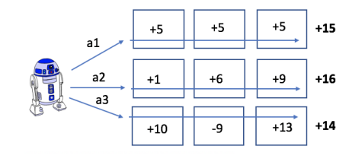
Maximize overall reward
Trade-off cumulative and immediate reward
Chess: position not pieces
Reinforce predicted reward and not reward

Slide 28
Q-learning
Reward learning
Q-learning
Discount factor
Estimate of future reward
One of many popular reinforcement learning algorithms
Update estimate of total reward
For actual reward received
This propagates backwards
Make choices based on estimated total

Slide 29
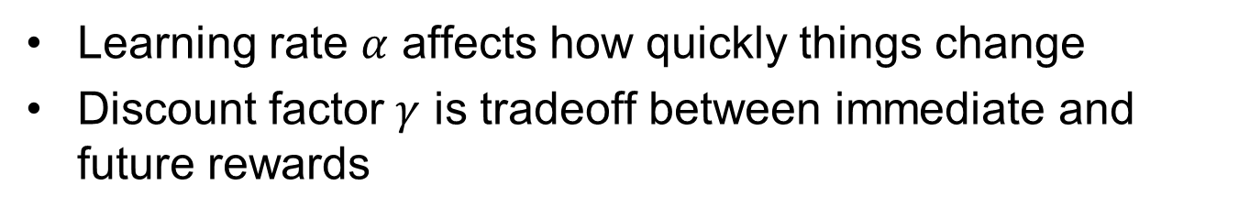
Q-learning
Discount factor
Estimate of future reward
Learning rate $α$ affects how quickly things change
Discount factor $γ$ is tradeoff between immediate and future rewards

Slide 30
Part 5
Biological reward prediction

Slide 31
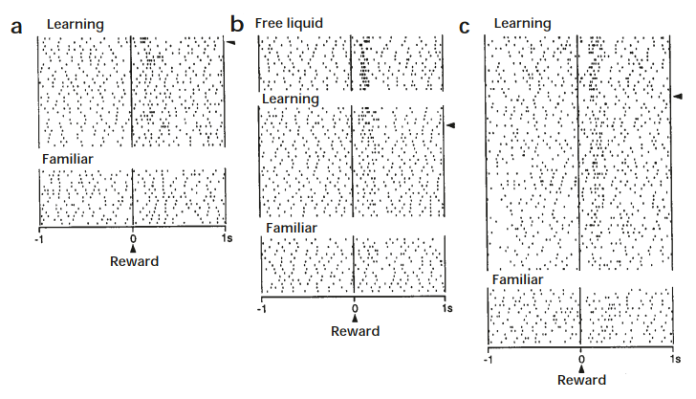
Dopamine neurons respond to reward
But only when it is unexpected
Hollerman Nature Neuroscience 1998 doi:10.1038/1124

Slide 32
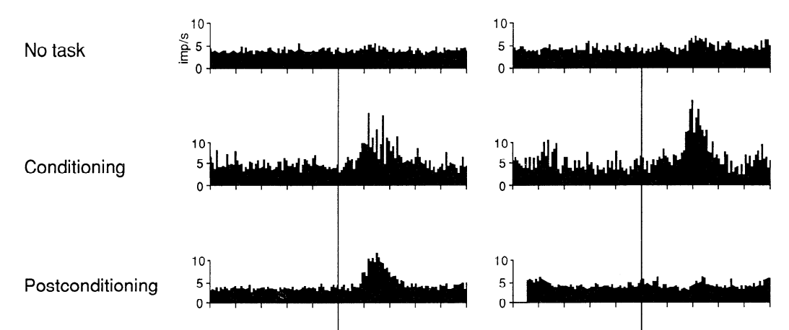
Dopamine response shifts to predictive stimulus
Light predicts reward
Schultz Journal of Neurophysiology 1990 doi:10.1152/jn.1990.63.3.607

Slide 33
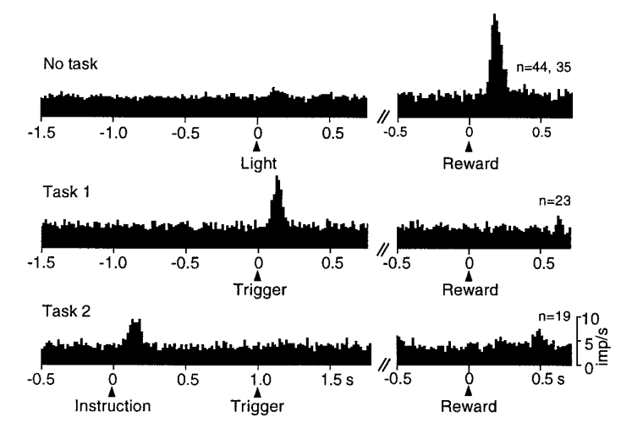
Can shift to earlier prediction
Shifts back to instruction that predicts trigger that predicts reward
Schultz Journal of Neurophysiology 1998 doi:10.1152/jn.1998.80.1.1

Slide 34
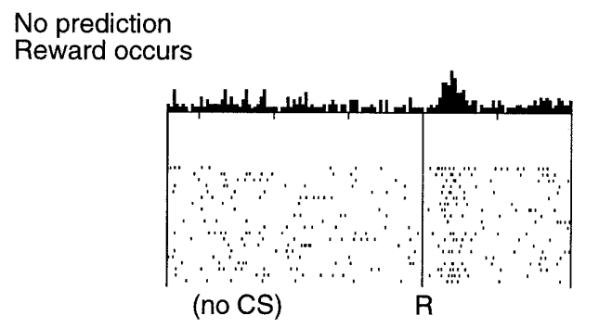
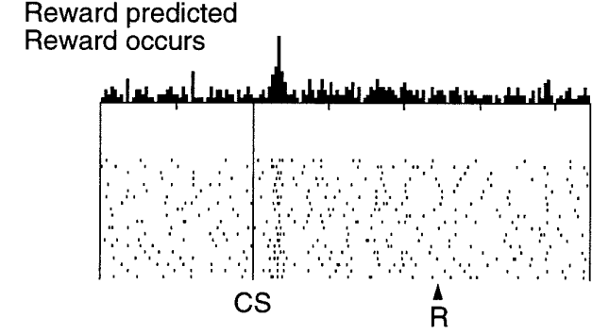
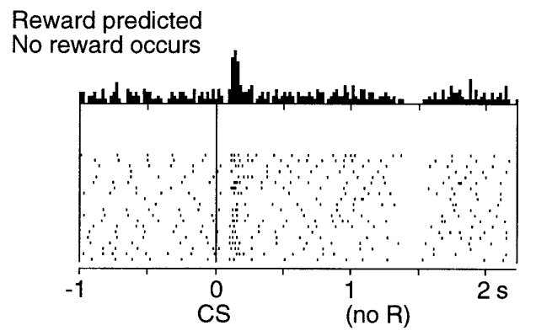
Dopamine response also indicates lack of predicted reward
Schultz Journal of Neurophysiology 1998 doi:10.1152/jn.1998.80.1.1

Slide 35
Dopamine may represent “reward prediction error”
Difference between expected and predicted reward
Useful for reinforcement learning
Learn rewards from this
Choose actions based on this

Slide 36
Part 6
Reward prediction in a biological circuit

Slide 37

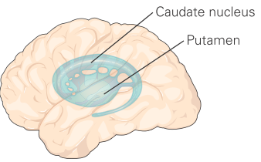
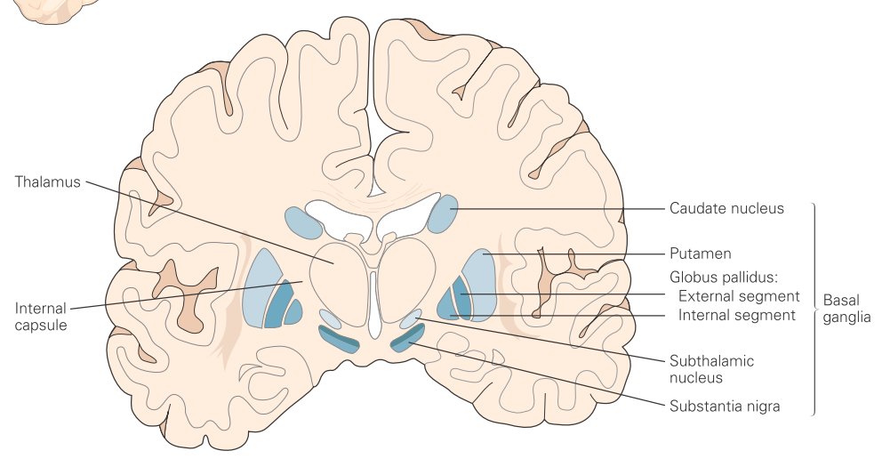

Slide 38
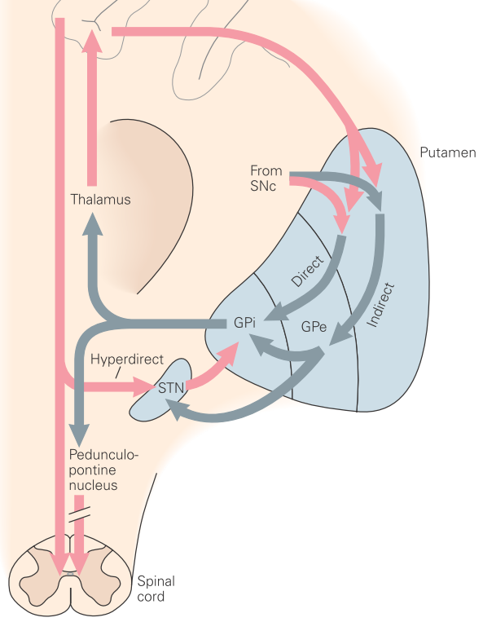
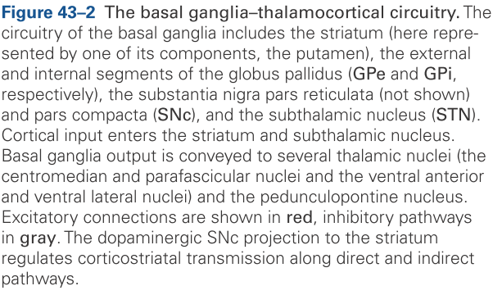

Slide 39
Dopamine disorders
Hypo disorders
Parkinson’s disease
Aging
Hyper disorders
Huntington’s
Tourette’s
Addiction and obsessive behaviors

Slide 40
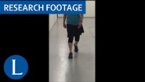
Parkinson’s disease
https://www.youtube.com/watch?v=pFLC9C-xH8E

Slide 41
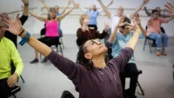
Using movement to help Parkinson’s
https://www.youtube.com/watch?v=2sqo5fZ_H5A

Slide 42

Huntington’s disease
https://www.youtube.com/watch?v=X5WwnmN2GUU

Slide 43
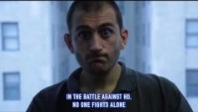
A Huntington’s disease patient
https://www.youtube.com/watch?v=m6SxJUjJGlc

Slide 44
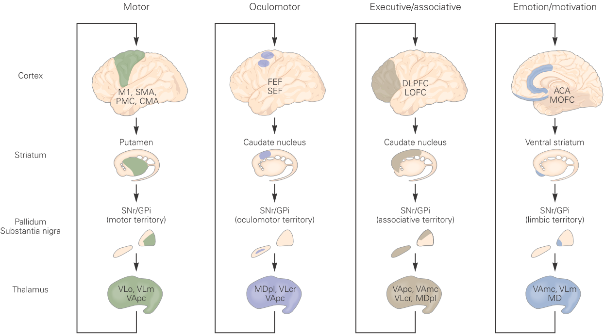

Slide 45
Part 7
Reward learning in perturbed reaching

Slide 46
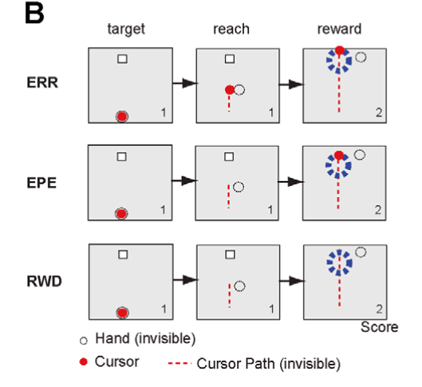
Teaching with errors and rewards
Error feedback
Endpoint feedback
Reward feedback
Izawa PLOS Computational Biology 2011 doi:10.1371/journal.pcbi.1002012

Slide 47
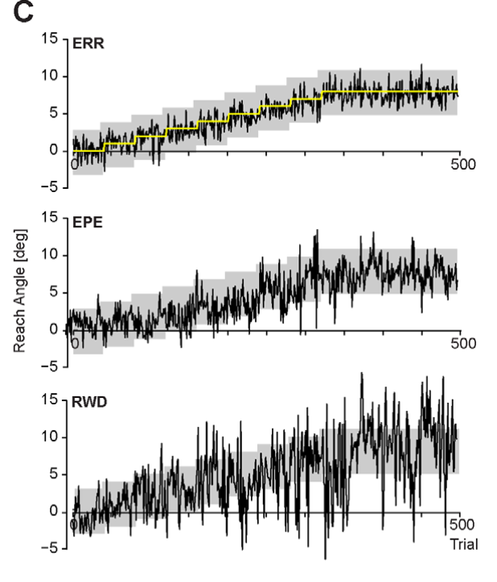
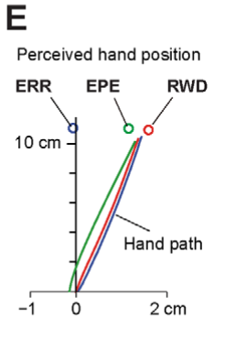
Learning from errors and rewards
Izawa PLOS Computational Biology 2011 doi:10.1371/journal.pcbi.1002012

Slide 48
Part 8
Modeling reward and error learning

Slide 49
Model the movements
Hand and cursor
Internal estimates
Vectorization
Izawa PLOS Computational Biology 2011 doi:10.1371/journal.pcbi.1002012

Slide 50
Kalman filter as error based learning
Kalman filter
State equations
Kalman gain
Izawa PLOS Computational Biology 2011 doi:10.1371/journal.pcbi.1002012

Slide 51
State variance
State equations
Variance propagation
Kalman filter

Slide 52
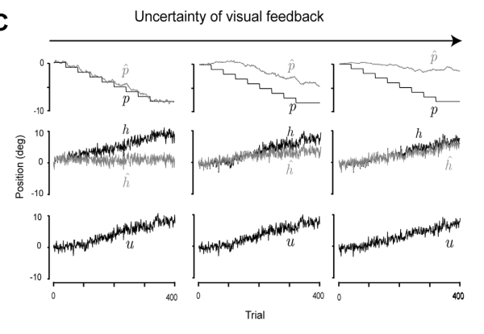
Credit assignment problem

Slide 53
Deciding on the movement
Control policy
State equations
Kalman filter
Variance propagation

Slide 54
Reward based learning
State equations
Policy learning
Kalman filter
Control policy
Reward learning

Slide 55
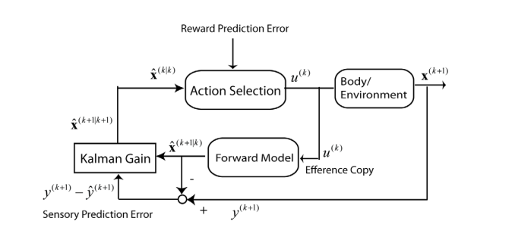
Box and arrow diagram of the model

Slide 56
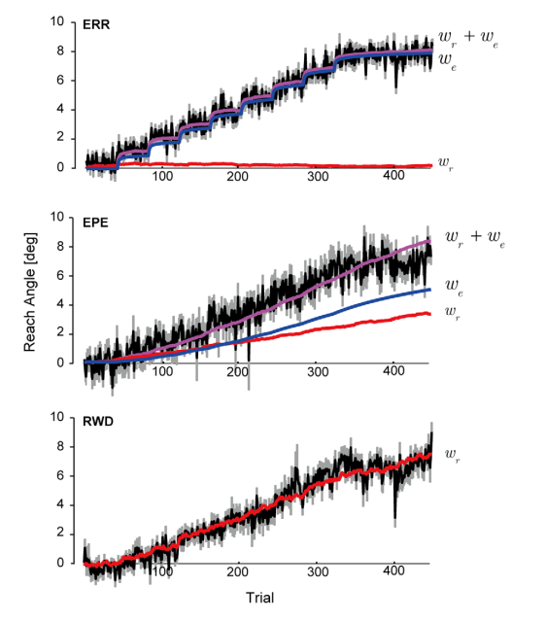




Model successfully learns from error or reward
$$\hat{p}$$
$$\hat{p}$$
$$\hat{p}$$
$$\hat{p}$$

Slide 57
In class
Use the equations in the lecture to reproduce the figure on the previous slide.

